Slide 1
What is Continuous Delivery?
Continuous Delivery is the ability to get changes of all types—including new features, configuration changes, bug fixes and experiments—into production, or into the hands of users, safely and quickly in a sustainable way.

Slide 2
Why continuous delivery?
Low risk releases
Faster reaction times
Flexible release options
Lower costs
Focused staffing
Emphasis on culture
Happier teams

Slide 3
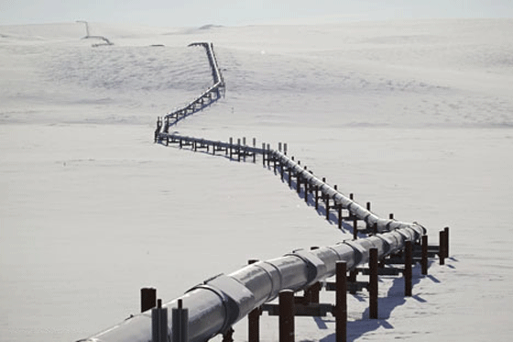
A continuous delivery pipeline enables deployment and automated testing of code
on environments which gradually become more ‘live like’.

Slide 4


First, our clever developers will write some code on their local machines.

Slide 5


When the code is complete, they will run all their unit tests.

Slide 6

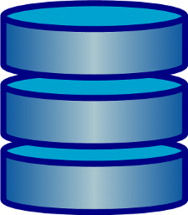
When all the tests pass then they check-in to source control.

Slide 7
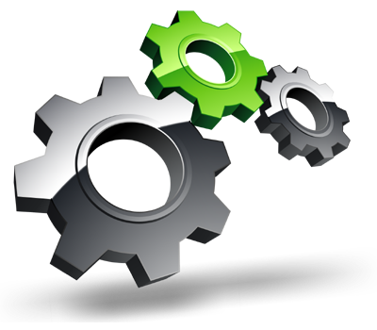

The source control triggers a new job in Jenkins.
This is the first phase of our Continuous Delivery pipeline.

Slide 8
Continuous Delivery Pipeline
Continuous Integration Environment
Test Automation Environment
Staging Environment
Production Environment
The pipeline consists of a number of different environments onto which we will deploy code and run tests to verify the code works as expected.

Slide 9

Continuous Delivery Pipeline
Continuous Integration Environment
Test Automation Environment
Staging Environment
Production Environment
On the Continuous Integration environment we run our unit tests every time a developer pushes code to source control.

Slide 10
Continuous Delivery Pipeline
Continuous Integration Environment
Test Automation Environment
Staging Environment
Production Environment
In the Test Automation environment out sites are deployed but external systems are faked. This is where we run our full suite of automated acceptance tests.

Slide 11
Continuous Delivery Pipeline
Continuous Integration Environment
Test Automation Environment
Staging Environment
Production Environment
In Staging sites are deployed the same as on Prod with real external dependencies.
Here we check that everything works when connected.

Slide 12
Continuous Delivery Pipeline
Continuous Integration Environment
Test Automation Environment
Staging Environment
Production Environment
A small set of automated tests are run after deploying to Production to make sure everything went well and the environment is operational.

Slide 13
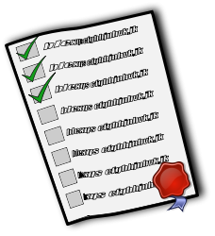
Continuous Delivery Pipeline
Continuous Integration Environment
Test Automation Environment
Staging Environment
Production Environment
In order for each environment to receive a deployment, the previous environment in the pipeline must receive a successful deployment and pass all its tests.

Slide 14
Continuous Delivery Pipeline
Continuous Integration Environment
Test Automation Environment
Staging Environment
Production Environment
Therefore, the continuous delivery pipeline consists of a number of phases which, when successful, leads to a potential deployment of the next phase.

Slide 15

Continuous Delivery Pipeline
Continuous Integration Environment
Test Automation Environment
Staging Environment
Production Environment
Phase 1 involves rerunning the unit tests on the Continuous Integration boxes.

Slide 16
Continuous Delivery Pipeline
Continuous Integration Environment
Test Automation Environment
Staging Environment
Production Environment
The actual websites are not deployed. Tests are run directly against the code. The tests don’t open browsers.

Slide 17


Continuous Delivery Pipeline
Continuous Integration Environment
Test Automation Environment
Staging Environment
Production Environment
Any failures result in a broken build. The appropriate developers would be informed and fixing the build would become top priority.

Slide 18
Continuous Delivery Pipeline
Continuous Integration Environment
Test Automation Environment
Staging Environment
Production Environment
When the build passes on the Continuous Integration Environment then that build is promoted to the Test Automation Environment.

Slide 19


Continuous Delivery Pipeline
Continuous Integration Environment
Test Automation Environment
Staging Environment
Production Environment
Once built on the Test Automation Environment an automated smoke test is run.

Slide 20
Continuous Delivery Pipeline
Continuous Integration Environment
Test Automation Environment
Staging Environment
Production Environment
If the smoke tests pass then the full Automated Acceptance Test suite is run.

Slide 21
Continuous Delivery Pipeline
Continuous Integration Environment
Test Automation Environment
Staging Environment
Production Environment
Just like before, if we encounter failures, then the appropriate people are notified and fixing the build becomes top priority.

Slide 22


Continuous Delivery Pipeline
Continuous Integration Environment
Test Automation Environment
Staging Environment
Production Environment
If the whole suite passes on one browser then we re-run on a variety of other supported browsers.

Slide 23
Continuous Delivery Pipeline
Continuous Integration Environment
Test Automation Environment
Staging Environment
Production Environment
When everything passes on the Test Automation Environment then the build gets promoted and is available for deploy on the Staging Environment.

Slide 24
Continuous Delivery Pipeline
Continuous Integration Environment
Test Automation Environment
Staging Environment
Production Environment
Just like the Test Automation Environment a Smoke Test Suite is run against the Staging Environment.

Slide 25
Continuous Delivery Pipeline
Continuous Integration Environment
Test Automation Environment
Staging Environment
Production Environment
If the Smoke Test Suite passes then a subset of the overall test suite is run to ensure that, when in a live-like environment, the app still behaves as expected.

Slide 26
Continuous Delivery Pipeline
Continuous Integration Environment
Test Automation Environment
Staging Environment
Production Environment
Once all the Automated Acceptance Tests are passing on the Staging Environment then the build becomes a potentially releasable build.

Slide 27
Continuous Delivery Pipeline
Continuous Integration Environment
Test Automation Environment
Staging Environment
Production Environment
When released to the Production Environment then a final small subset of Automated Acceptance Tests are run as a health check to ensure everything is OK.

Slide 28
Continuous Delivery Pipeline
Continuous Integration Environment
Test Automation Environment
Staging Environment
Production Environment
If any problems are encountered by the health check tests then the appropriate people are informed.

Slide 29
Continuous Delivery Pipeline
Continuous Integration Environment
Test Automation Environment
Staging Environment
Production Environment
Otherwise, we have just completed a successful deployment through our delivery pipeline.

Slide 30

Continuous Delivery Pipeline
Continuous Integration Environment
Test Automation Environment
Staging Environment
Production Environment

